Slide 1


I SPY AI
Team No. : 5
Team Members and Roll No.
Mehak Garg - 2210990572
Mehak Goel - 2210990573
Mehak Kharbanda - 2210990574
Mehak Sharma - 2210990575
Submitted to : Monica Dutta ma’am

Slide 2
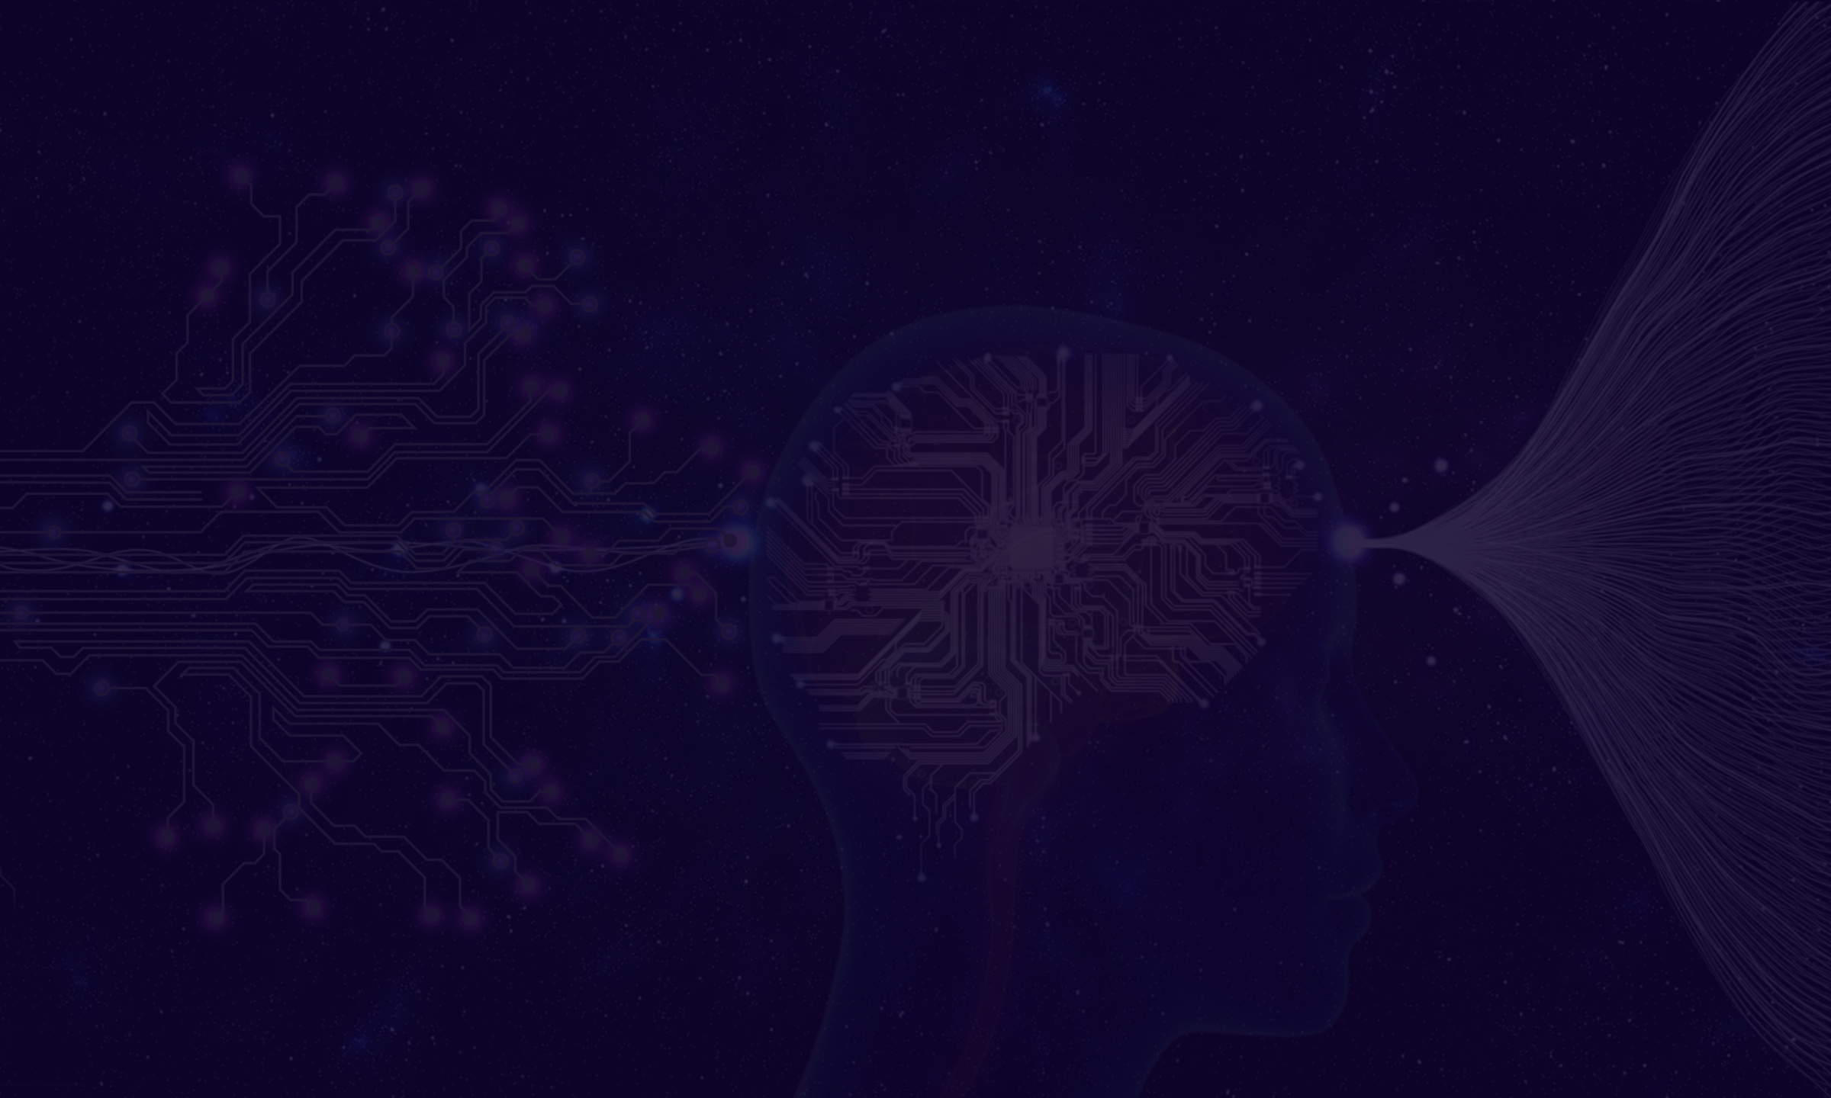

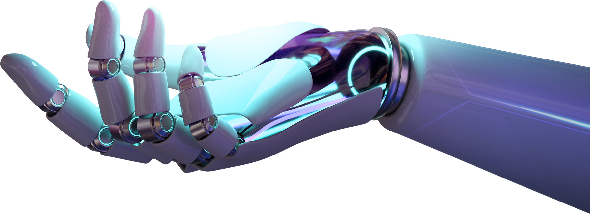
Introduction
Machine Learning and Data Science are one of the fastest-growing technological fields.
The main reason for the advancement in this field is the increase in the computational power and availability of large amounts of data.
This data is analyzed and made suitable for creating machine learning models and products.
In this project, we are going to discuss the IPL team win prediction. Based on some match stats, we’re predicting who is the winner of an IPL match.

Slide 3
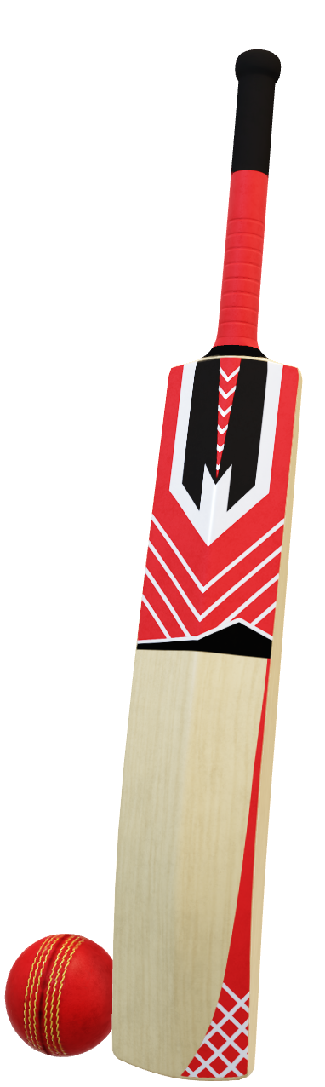
Problem Statement
In sports, particularly cricket and football, prediction techniques are utilized to anticipate scores, rankings, winners and other outcomes.
However, developing a reliable machine learning model to accurately predict IPL match outcomes and analyze player performances poses a significant challenge.
The IPL Sports Predictor Project aims to overcome this challenge by using historical data, advanced predictive modeling techniques, and computerized algorithms to create a robust predictor.
Through the integration of probability analysis, regression modeling, and other predictive techniques, the IPL Sports Predictor Project aims to revolutionize the way IPL matches are analyzed and experienced.

Slide 4

Objective
Accurate Match Predictions: We have developed a model that accurately predicts IPL match outcomes, including winner identification and performance metrics for players and teams.
Strategic Insights: Providing stakeholders with actionable insights for strategic decision-making, including batting orders and bowling strategies based on historical performance data.
Fan Engagement and Excitement: Increasing fan engagement and excitement by offering personalized match predictions, analysis, and interactive experiences, enhancing the overall viewing experience.
Continuous Model Refinement: Implementing mechanisms for continuous model refinement, using new data and advanced algorithms to improve prediction accuracy and adapt to evolving trends in cricket.

Slide 5

Dataset
The dataset we are using here is the IPL dataset, which contains the details regarding the winner and match stats.
It contains the details like teams played, winner, venue of the match, won by how many wickets and runs, toss decision, whether DLS applied or not, names of the umpires etc.
Including exploratory data analysis is crucial for comprehensive analysis and model development.

Slide 6
Dataset Overview
batting_team, bowling_team, over ball, batsman, non_striker, bowler, is_super_over wide_runs, bye_runs
City, date, team1, team2, toss_winner, toss_decision, result, dl_applied, winner, win_by_runs, win_by_wickets, player_of_match, venue, umpire1, umpire2
Numberofballs, average, strikerate
home_wins, away_wins, home_matches, away_matches, home_win_percentage, away_win_percentage
Player_Name, DOB, Batting_Hand, Bowling_Skill, Country

Slide 7
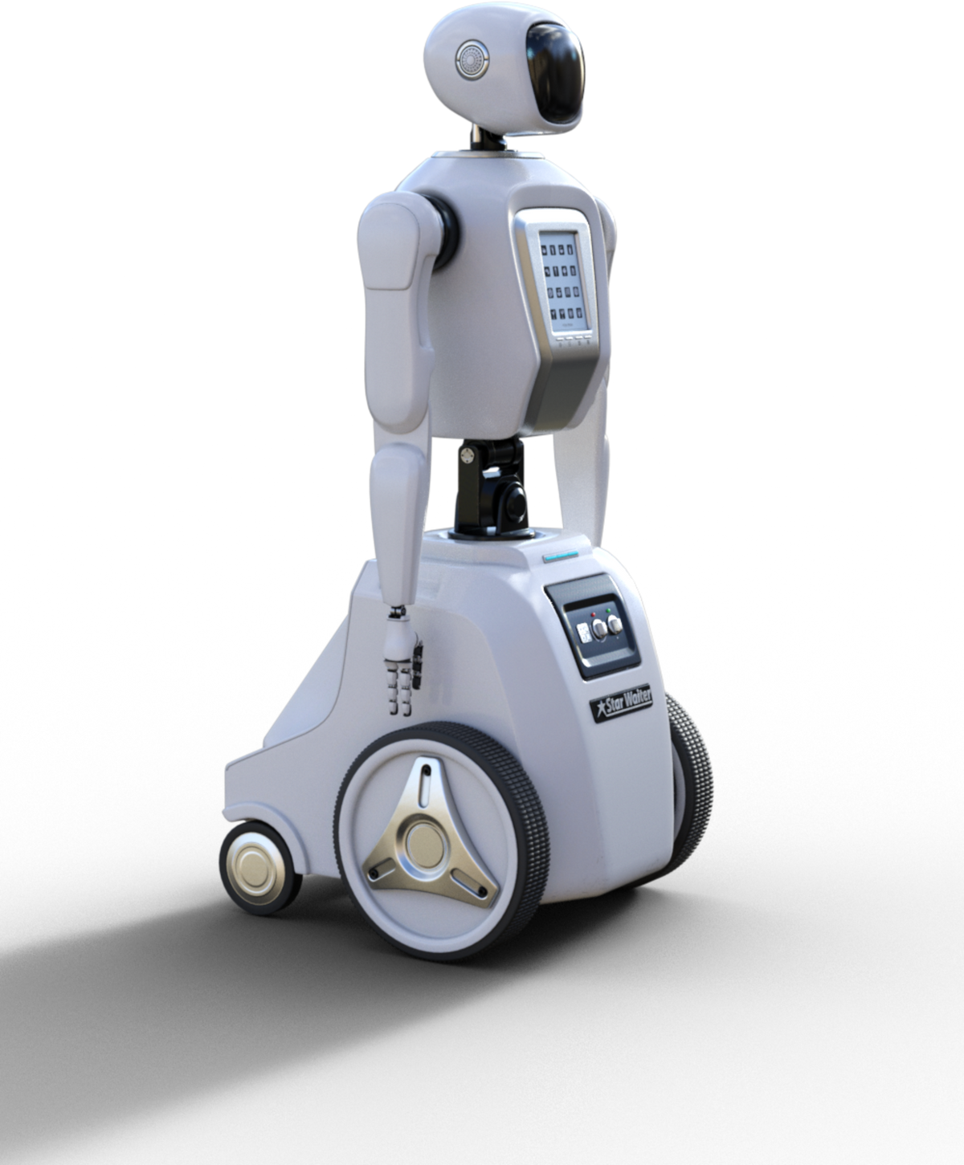
Algorithm
Data Collection: gather IPL match data including details like venue, teams, players, scores, and outcomes.
Feature Engineering: extract relevant features like player averages, team performance, etc.
Data Visualization: Incorporate visually appealing charts, graphs, and interactive visualizations to effectively communicate trends, patterns, and insights derived from the IPL match data.
Model Selection and Training: used appropriate ML algorithms (Logistic Regression) and train models on the preprocessed data.
Deployment: Integrate the trained model and generate predictions and display them to users.

Slide 8


Applications
Broadcasting and Commentary: Broadcasters and commentators can use predictions to enhance the analysis and commentary during IPL matches, providing deeper insights into players' performances and match dynamics.
Sponsorship and Marketing: Sponsors and advertisers can use predictions to identify high-profile matches and target their marketing campaigns more effectively, maximizing their return on investment.
Gamification and Interactive Experiences: IPL sports predictors can be integrated into gaming platforms or mobile apps to create interactive experiences, quizzes, and prediction games, driving user engagement and retention.
Team Management and Strategy: IPL team management can utilize predictions to analyze opponent strengths and weaknesses, optimize team selection, batting orders, and bowling strategies.

Slide 9
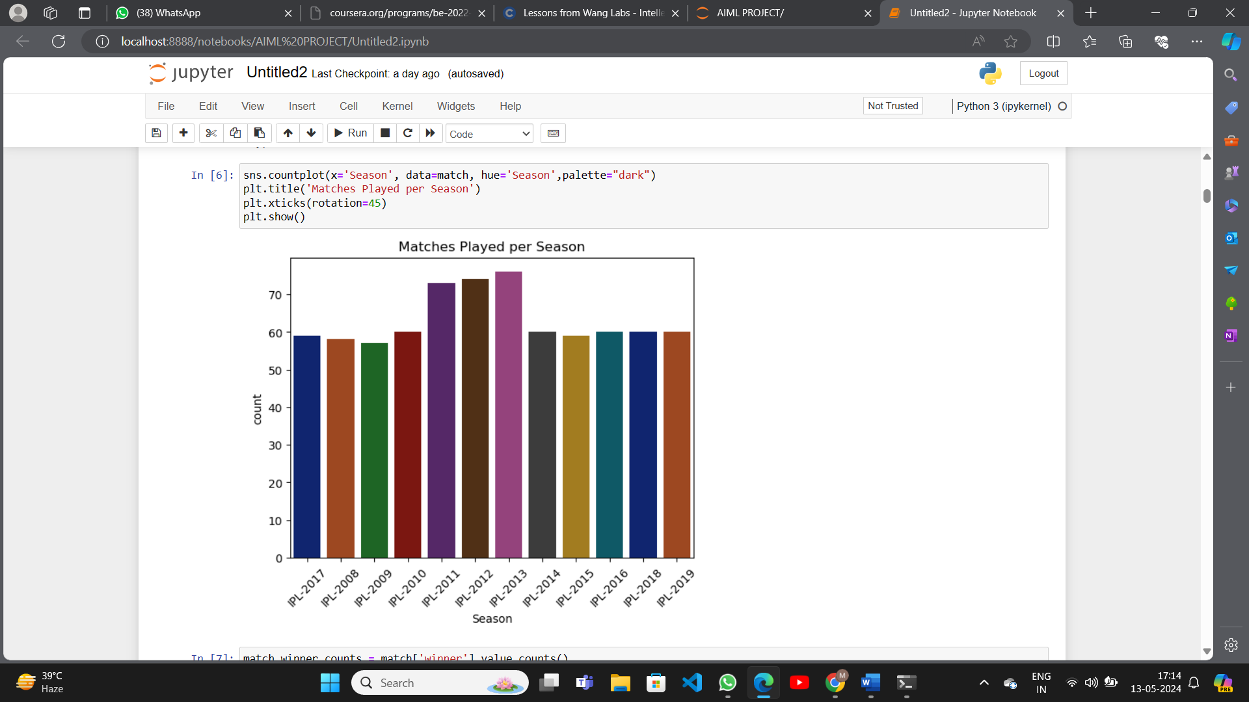
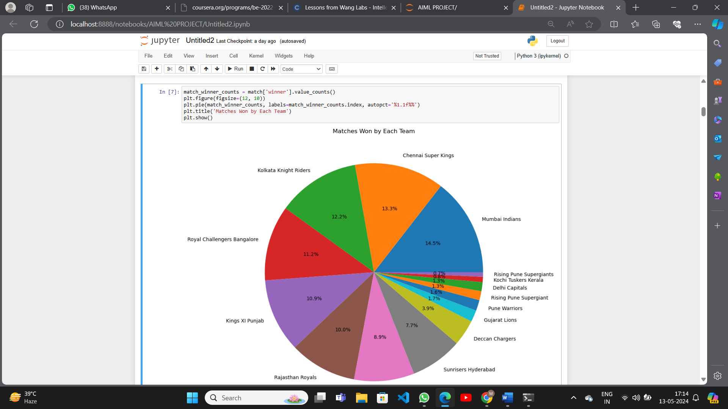
Results

Slide 10
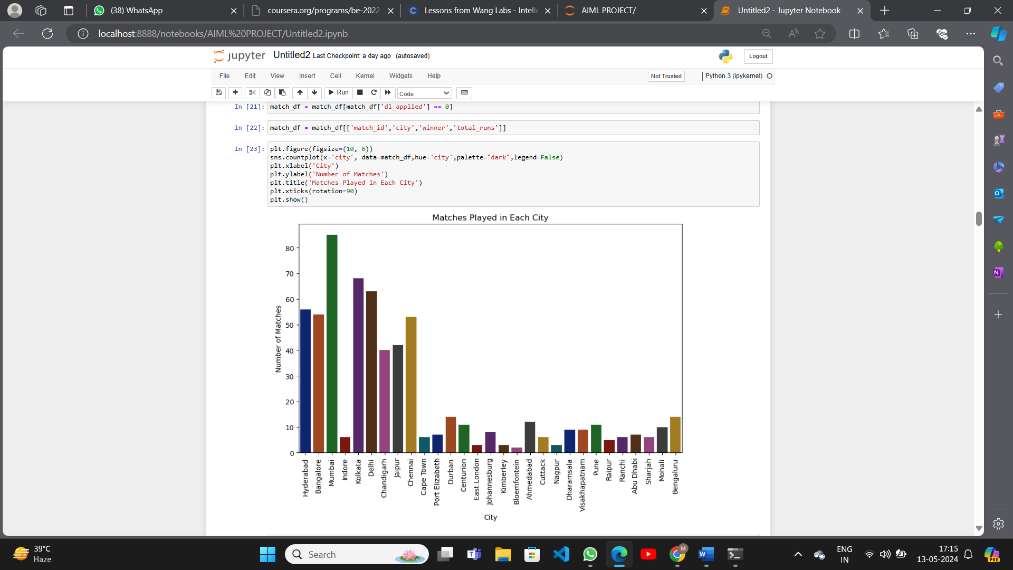
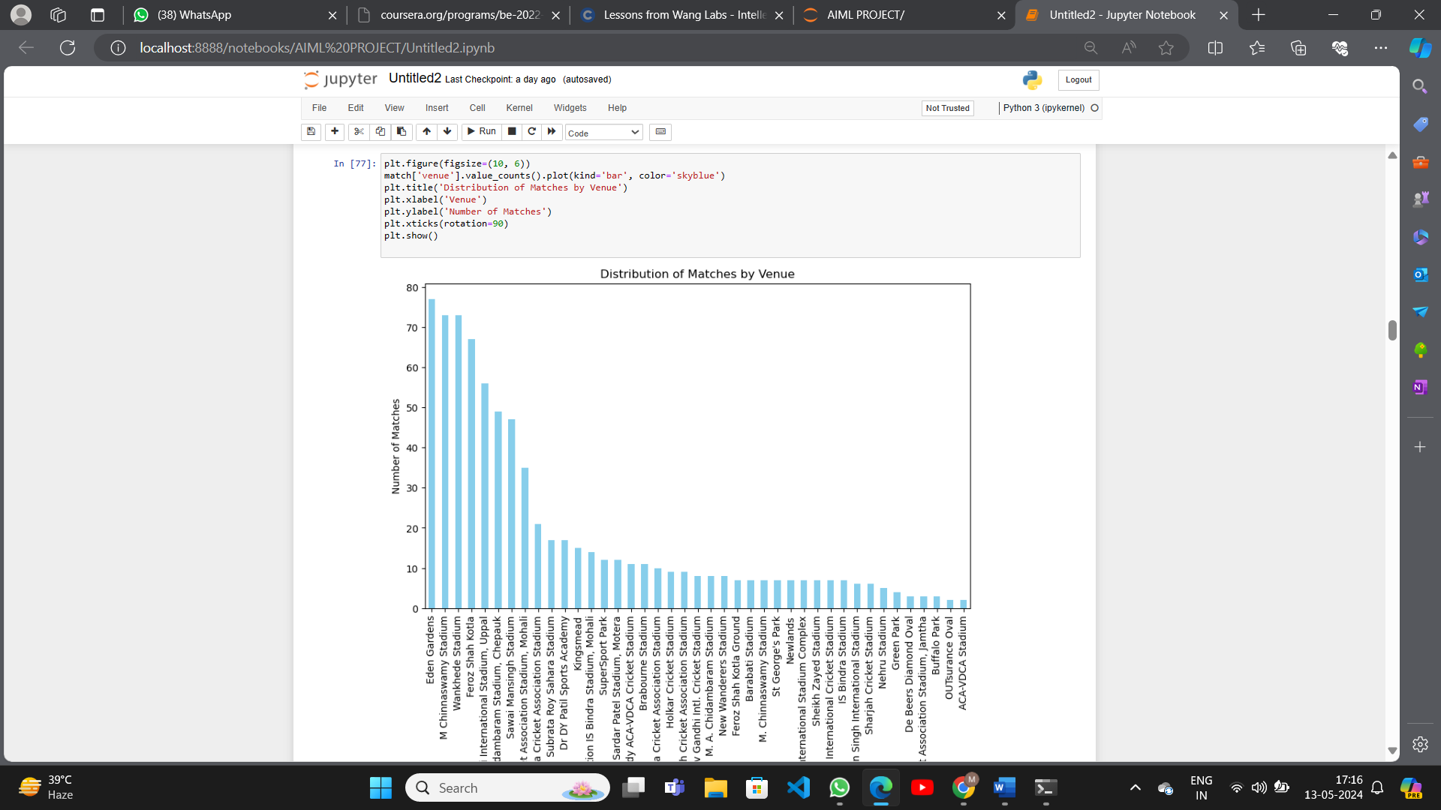
Results

Slide 11
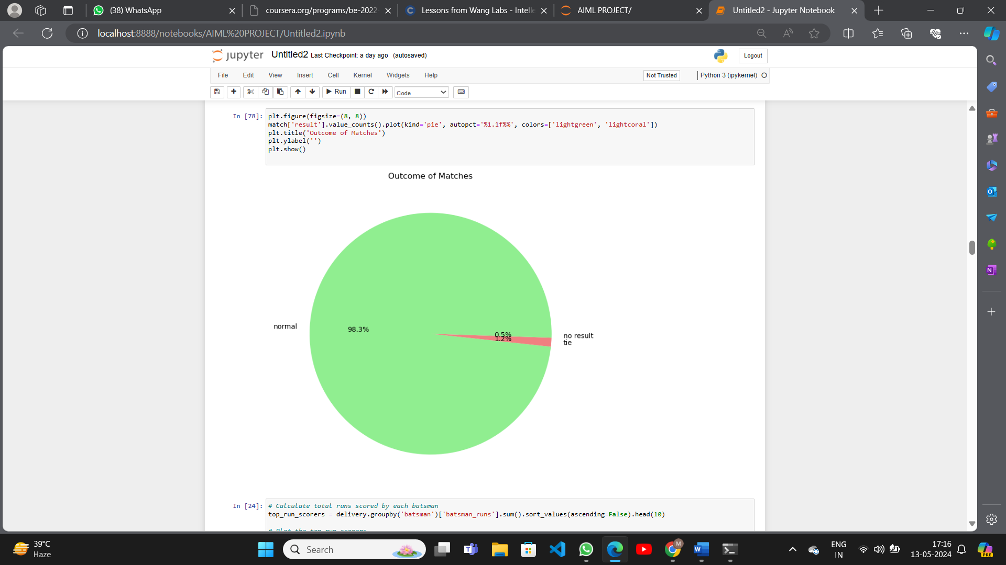
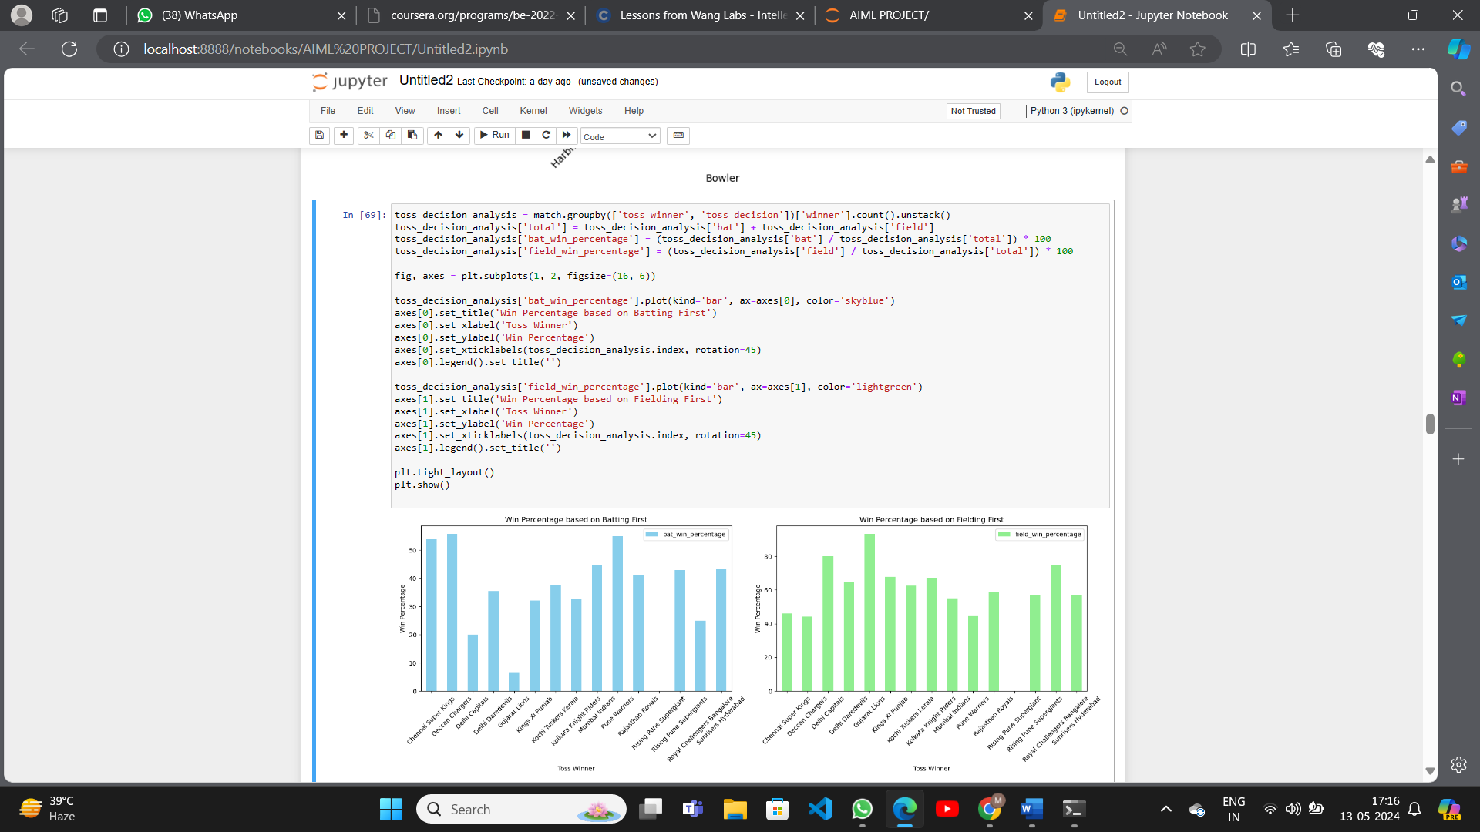
Results

Slide 12
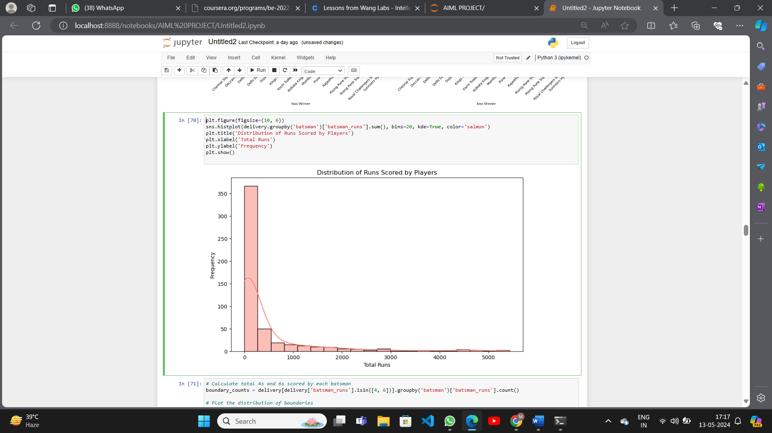
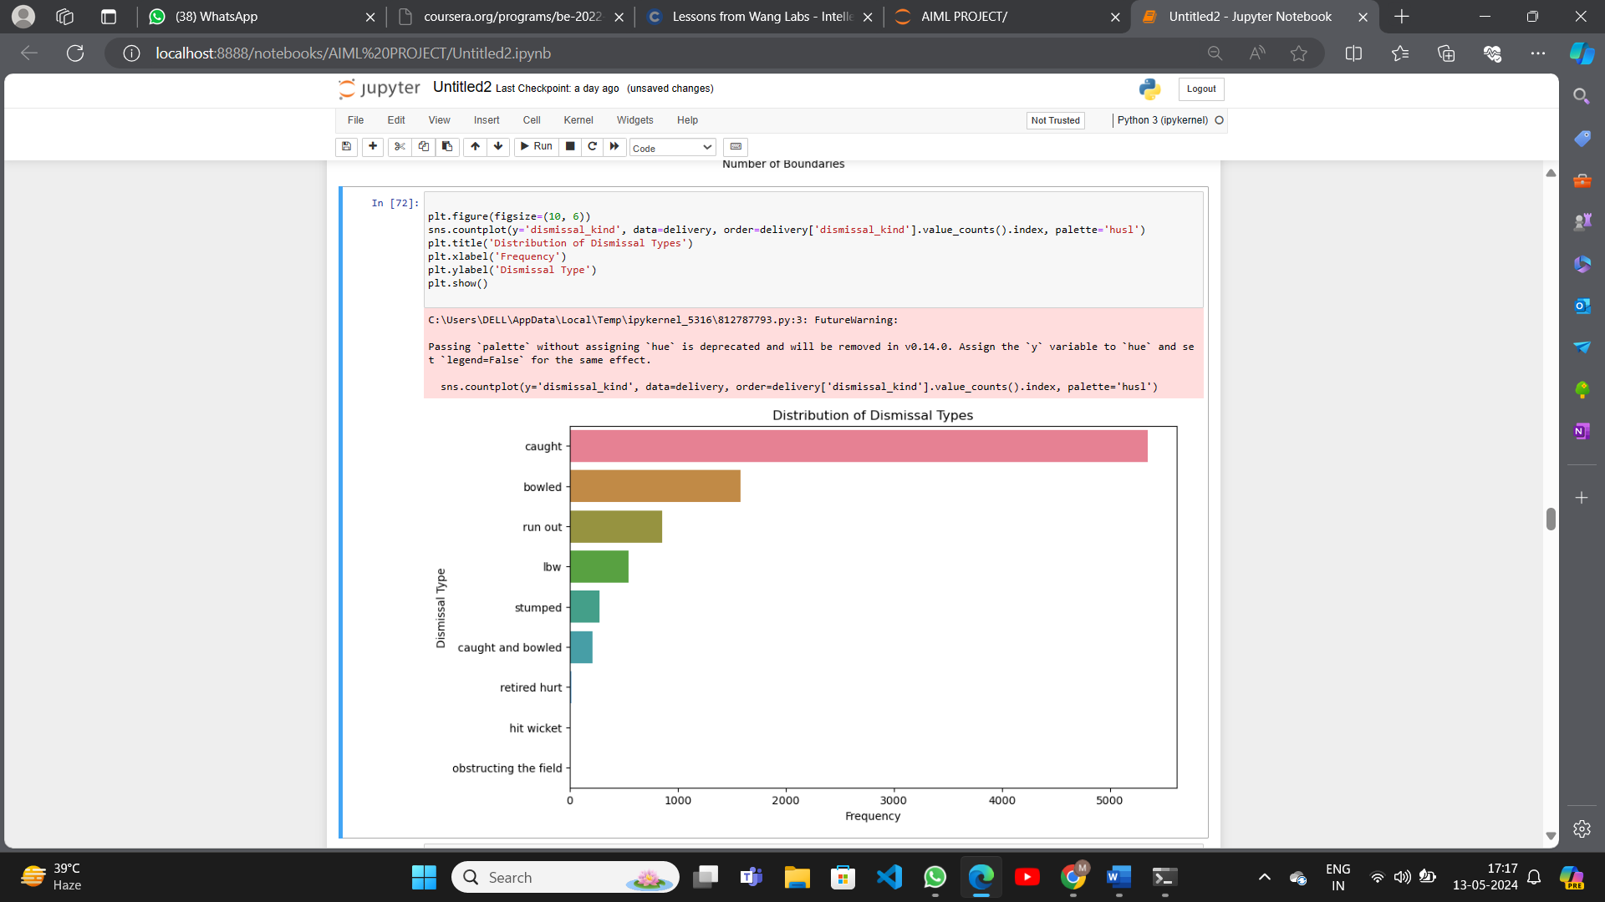
Results

Slide 13
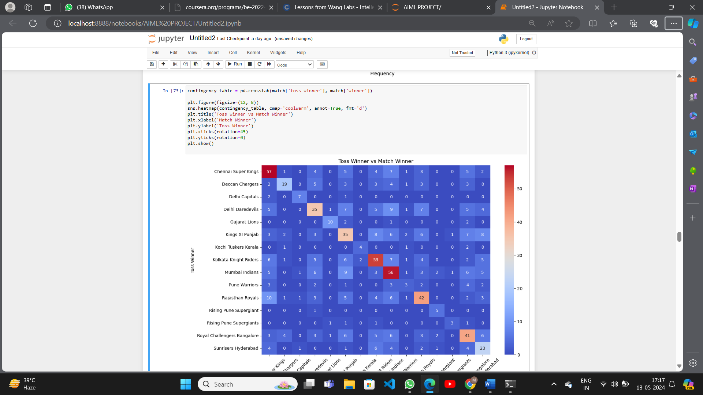
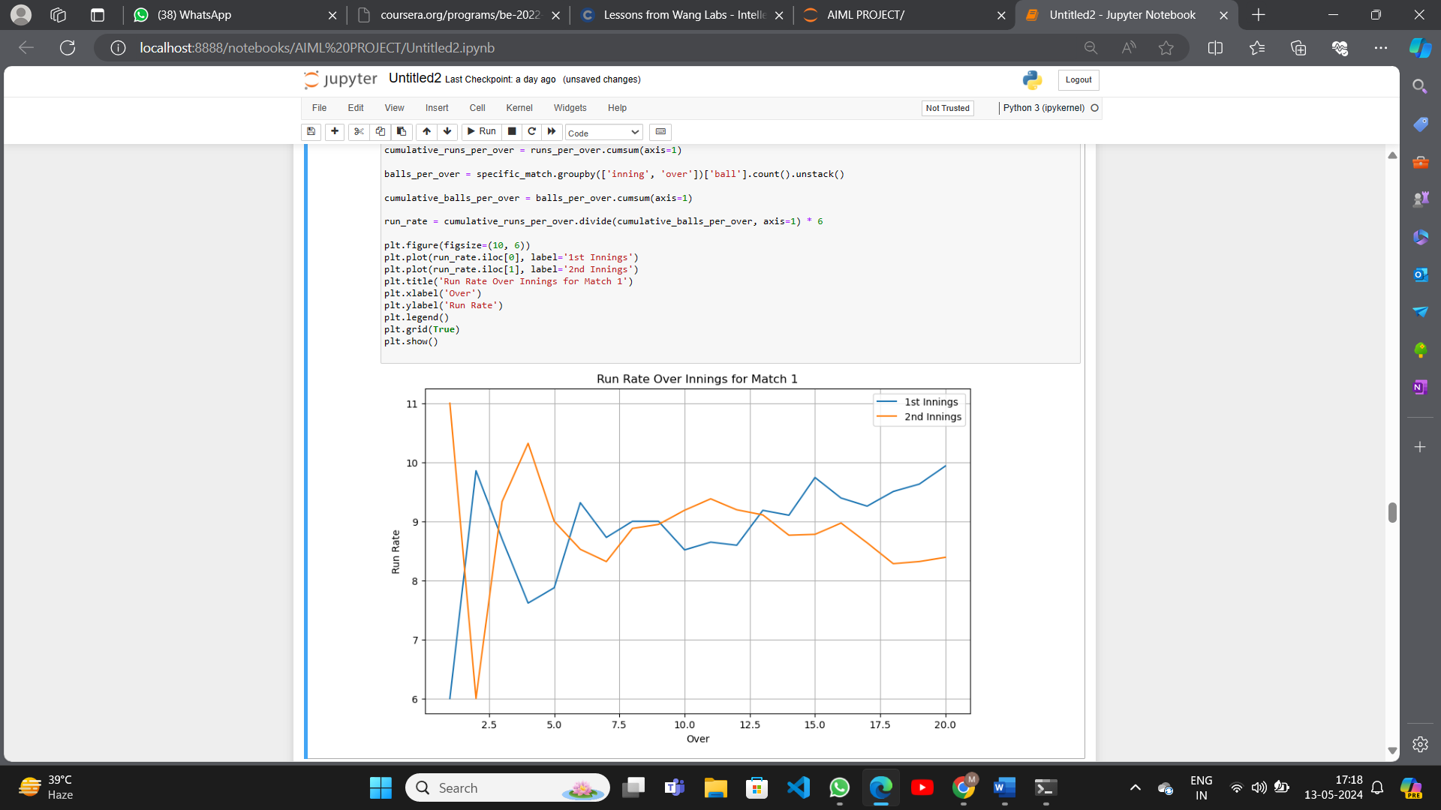
Results

Slide 14
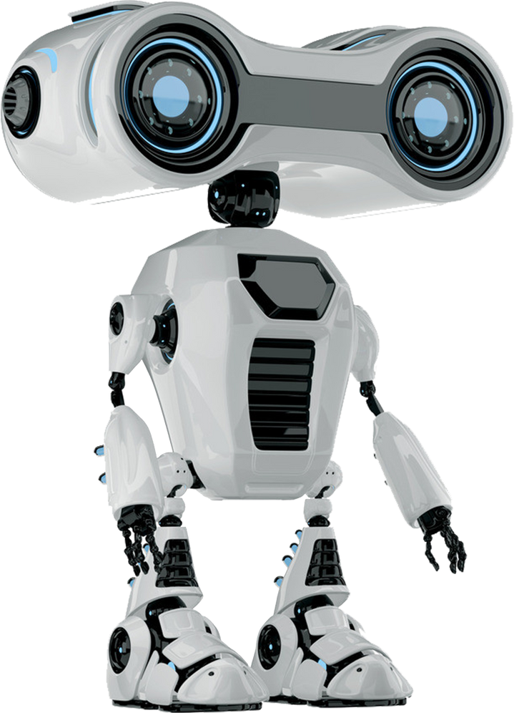
Conclusion
Here are the main key points from the article:
IPL Dataset analysis: This analysis includes checking for null values and replacing them, describing the dataset’s feature columns, and analyzing each feature.
Visualization of data: Done a graphical representation of the dataset in order to get an understanding of the teams, matches and the toss decision of the IPL Matches
Performed preprocessing techniques on the IPL Data: Performed several feature engineering techniques in order to make the dataset suitable for making the model. Encoding for converting categorical features to numerical features and techniques to avoid null values are used.
Model creation and Evaluation: This was the main part of the project, and we used the RandomForestClassifier model. Later we tested this model with the test set for evaluation.

Slide 15

Reference
Dataset: https://www.kaggle.com/datasets/ramjidoolla/ipl-data-set
Project: https://www.codespeedy.com/sports-predictor-using-python-in-machine-learning/

Slide 16

The End

